Slide 1
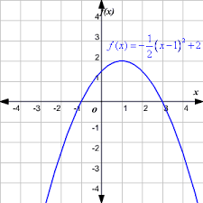
Bell Work (4–6 minutes)
Describe what you know

Slide 2
Some Examples of things we know: (3 – 4 minutes)
Maximum at (1,2)
also known as vertex (high or low point)
X-intercept at (-1,0) and (3,0)
also called roots, or zeros
Y-intercept at (0, 1.5)
Wide because lead coefficient is smaller 1
Opens down because lead coeff is negative
Given equation written in vertex form
______________
______________
______________
What else did you come up with?

Slide 3
Pre-calc trig
Day 13

Slide 4
Objective
Interpret quadratic (x squared) graphs
We will go over tests when Mr. Cuddy comes back

Slide 5
2.1 – Quadratic Functions and Models (3 – 4 minutes)
Objective: To identify important points of a quadratic function and model real life examples of their use
HLQ: Why do quadratic examples so up so often in real life situations? What is the common factor that causes this?

Slide 6
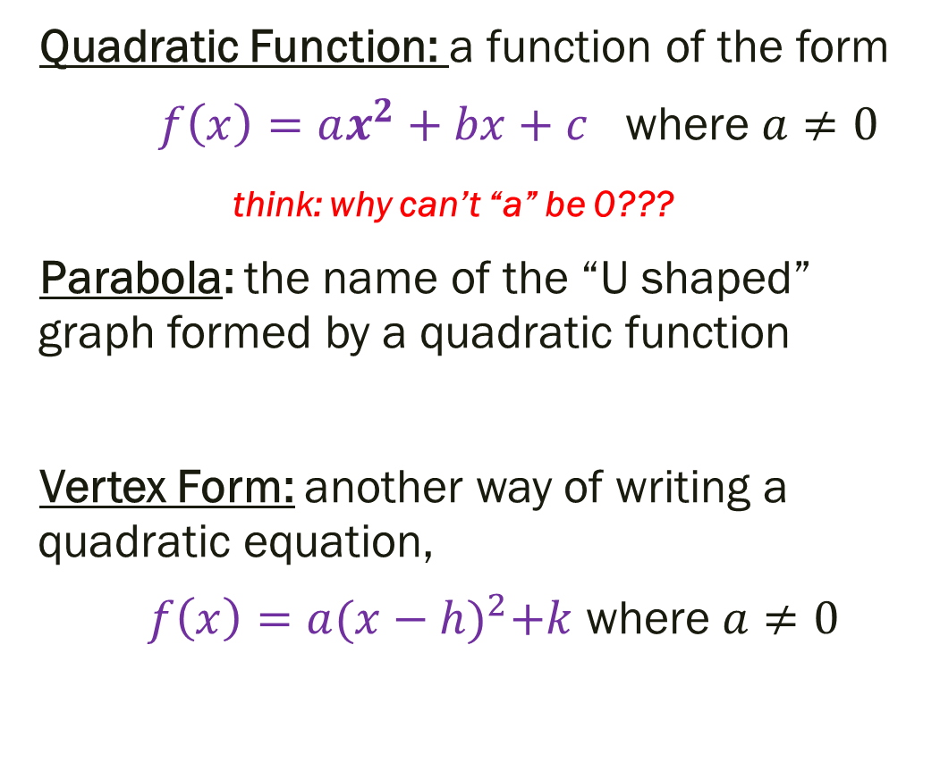
Some key terms and formulas (copy what you need 5 – 8 minutes)
Vertex: the highest (maximum) or lowest (minimum) point of a parabola where the axis of symmetry intersects our parabola (h, k)
Axis of Symmetry: The vertical line that divides our parabola into two mirror images of each other by passing through the vertex.
Answer to question before… if “a” is 0 then there is no squared value… in other words we have a line (not a parabola)
Quadratic Function: a function of the form
$f\left(x\right)=ax^{2}+bx+c$ where $a≠0$
think: why can’t “a” be 0???
Parabola: the name of the “U shaped” graph formed by a quadratic function
Vertex Form: another way of writing a quadratic equation,
$f\left(x\right)=a{(x−h)}^{2}+k$ where $a≠0$

Slide 7
Parabolas all around us (5 – 7 minutes
Parabolas are a very common shape in the real world. Discuss with the people around you the following questions (add what you want to your notes)
1.) What are some things that are in the shape of a parabola?
2.) What do these have in common?
3a.) When would we have a “highest point” when would we have a “lowest point”? 3b.) What do these points represent?

Slide 8
Parabolas all around us (2 – 4 minutes)
Parabolas are a very common shape in the real world.
What are some things that are in the shape of a parabola?
Objects being thrown, arches, bridges, jump ropes, rainbows, roller coasters, fountain, flashlight when put on a flat surface (use your phone to try it if you don’t believe me!), angry birds, satellites, _________
What do these have in common?
Strength – think bridges, arches! Gravity -- thrown objects, fountain, roller coasters Symmetry – same (but mirrored) path on both sides of the vertex
When would we have a “highest point” when would we have a “lowest point”? What do these points represent?
Depends on the direction of the parabola – max when upside down, min when opening up

Slide 9
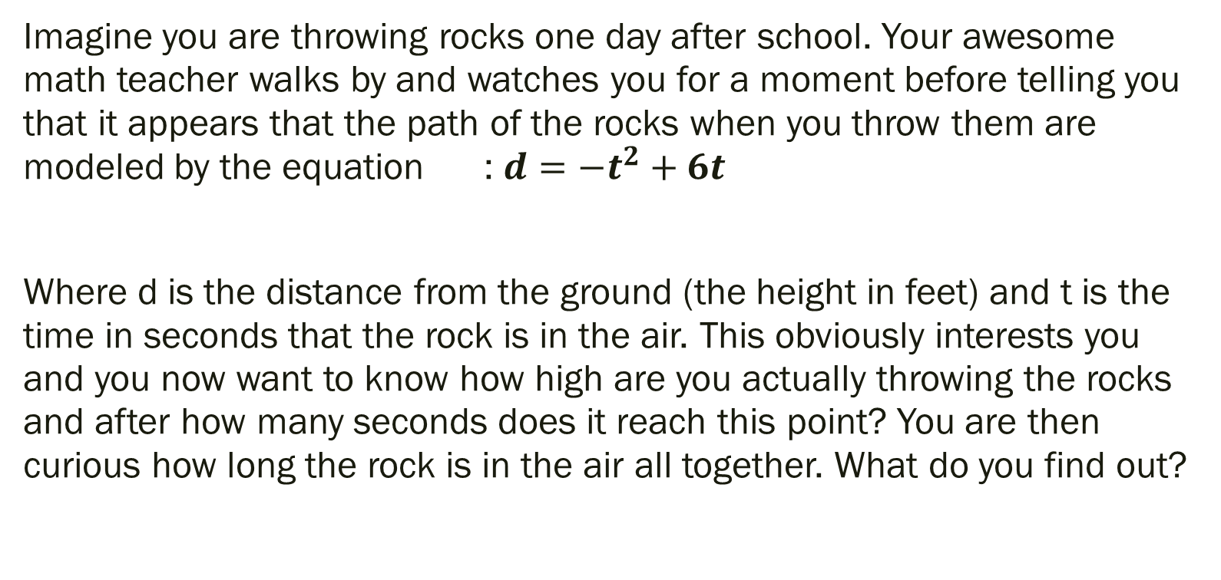
Example 1 (6 – 8 minutes) Attempt this on your own or in small groups
Imagine you are throwing rocks one day after school. Your awesome math teacher walks by and watches you for a moment before telling you that it appears that the path of the rocks when you throw them are modeled by the equation : $d={−t}^{2}+6t$
Where d is the distance from the ground (the height in feet) and t is the time in seconds that the rock is in the air. This obviously interests you and you now want to know how high are you actually throwing the rocks and after how many seconds does it reach this point? You are then curious how long the rock is in the air all together. What do you find out?

Slide 10
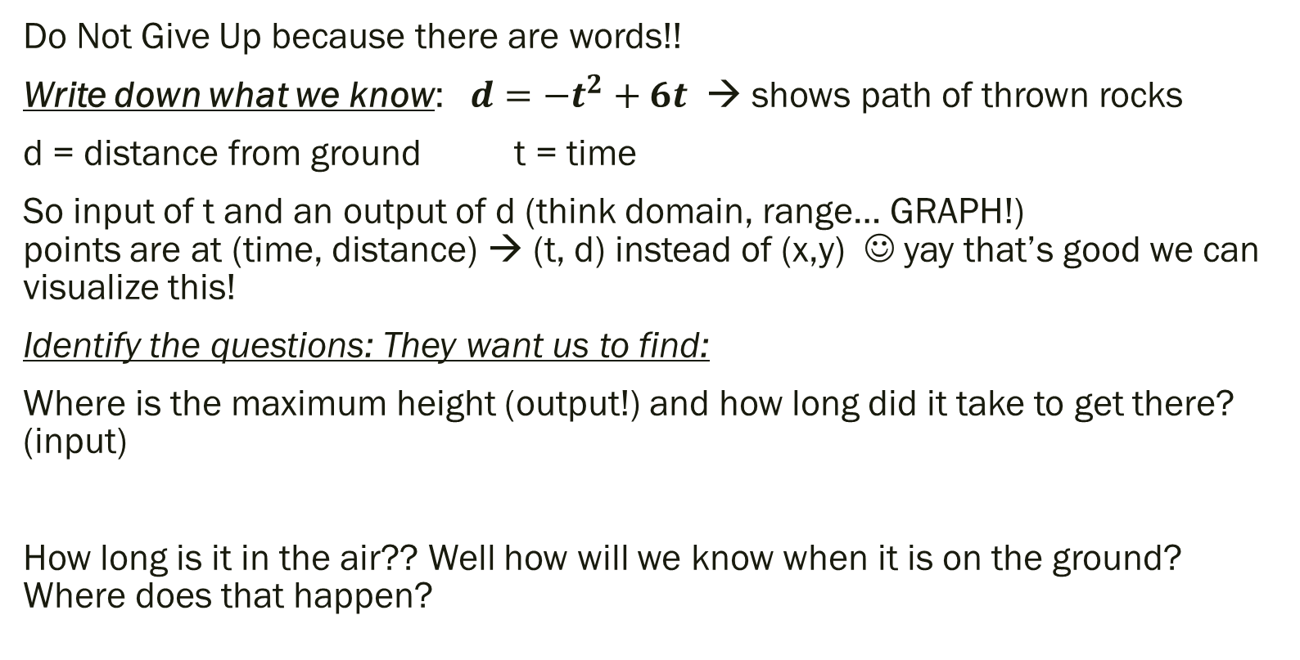
Example 1 Think Out Loud (3 – 5 minutes):
Do Not Give Up because there are words!!
Write down what we know: $d={−t}^{2}+6t$ → shows path of thrown rocks
d = distance from ground t = time
So input of t and an output of d (think domain, range… GRAPH!) points are at (time, distance) → (t, d) instead of (x,y) ☺ yay that’s good we can visualize this!
Identify the questions: They want us to find:
Where is the maximum height (output!) and how long did it take to get there? (input)
How long is it in the air?? Well how will we know when it is on the ground? Where does that happen?

Slide 11
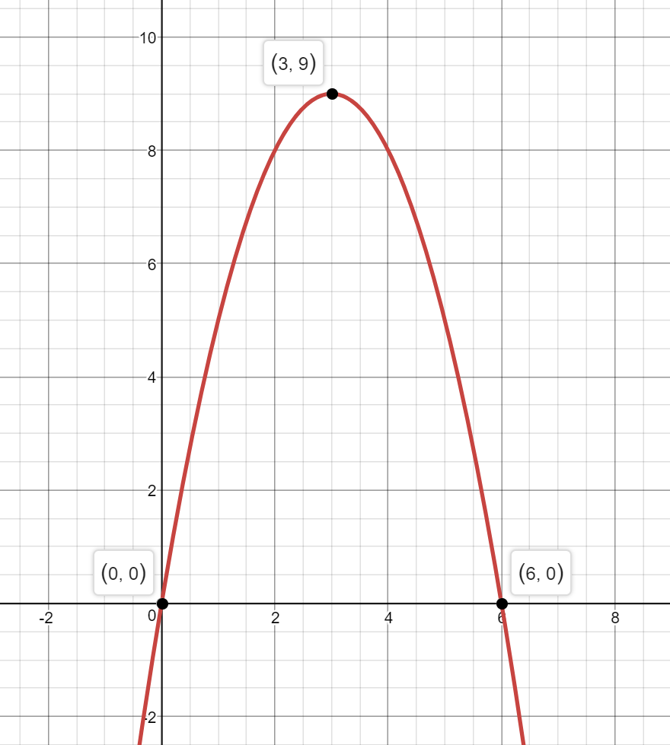

Example 1 Answers:
Rock doesn’t get higher than this!
Graph: $d={−t}^{2}+6t$
Max Height at vertex (3,9)
Input is 3 so that is time Output is 9 so that is distance.
So highest point is 9 feet after 3 seconds
Hits ground when height is 0. This happens twice, but only 1 makes sense. It happens at both 0 (0,0) and 6 (6,0) seconds.
The rocks hits the ground after 6 seconds.
Why is that the only one that makes sense?
d = distance from ground
t = time

Slide 12
HLQs For the Rock Problem (10 minutes) (Discuss in small groups → we’ll talk about these when I get back… but I want to hear your thoughts as a class… Wow me! ☺)
***Have someone in your group record your thoughts/answers/questions***
Was the individual standing up or laying down when they threw the rock?
Did the rock hit anyone or anything before hitting the ground?
Do you think you were trying to throw the rock as far as you could?
Does it take the rock shorter, longer, or the same amount of time to reach the maximum height after being thrown as it does to go from the maximum height back to the ground? Why? Justify your answer.
What else could you ask someone about the path of the rock?

Slide 13
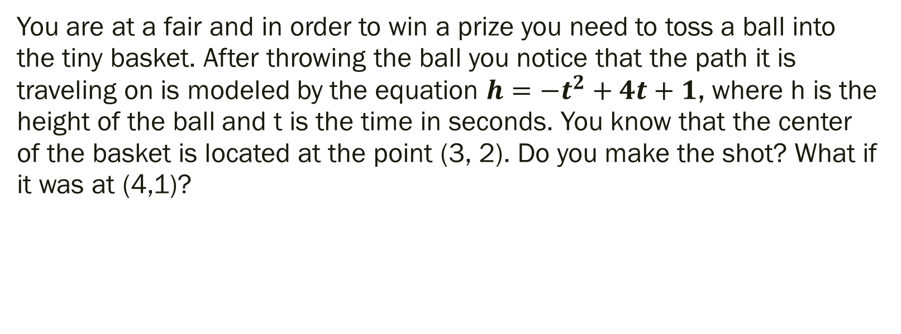
Example 2 (5 minutes) Attempt on your own or in small groups
You are at a fair and in order to win a prize you need to toss a ball into the tiny basket. After throwing the ball you notice that the path it is traveling on is modeled by the equation $h={−t}^{2}+4t+1$, where h is the height of the ball and t is the time in seconds. You know that the center of the basket is located at the point (3, 2). Do you make the shot? What if it was at (4,1)?

Slide 14
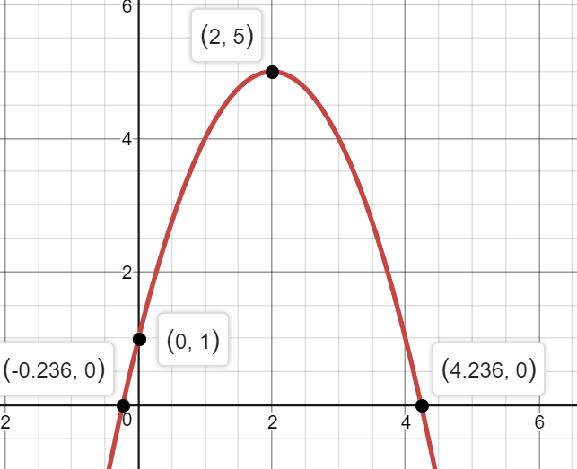
Example Answer
Look at the graph and visualize baskets at the given points.
Does the ball’s path take it into either of the baskets?
Basket 2 is located on the path of the ball, and is the only way you’ll win a prize.
Basket 1
(3, 2)
Basket 2
(4,1)

Slide 15
Additional Things to Think about at the Fair…
Are the buckets above or below the location of where you are shooting from?
How high are you shooting from?
How long did it take the ball to leave your hand and land in the second bucket?
After how many seconds would you be able to realize you weren’t going to make it into the first bucket?
What could you do in order to make it in the first bucket (without moving the bucket)?
Is that the only way to make the shot?
I am currently thinking of at least 3 ways to adjust your shot for it to go in… ☺

Slide 16
If you have homework from last chapter you need/want to finish you could do that now and I’ll still give you credit.
For next time… (rest of time to work)
Page 132 #7-12, 21-27 (odd), 76, 77, 81

Slide 17
Additional (Optional) Notes to follow this slide…
The following slides are some review from algebra 3-4 if needed
The vocabulary is not vital, and the steps can all be eliminated by using a graphing calculator appropriately

Slide 18
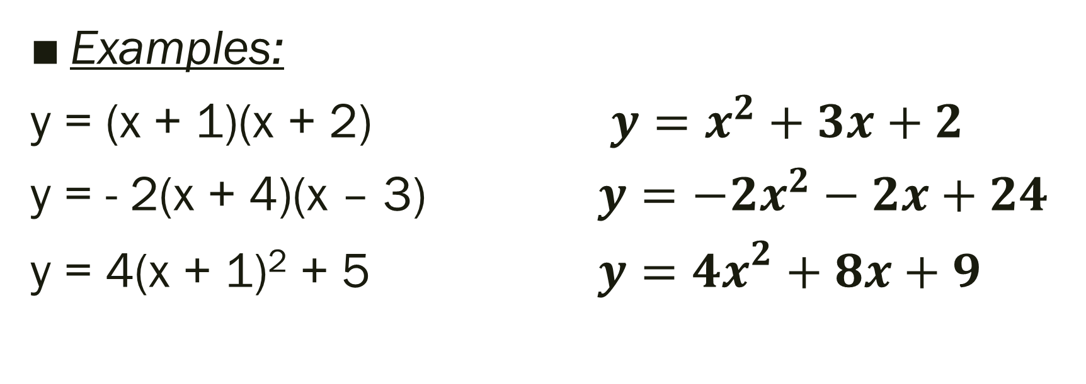
Write the equation in Standard Form:
Examples:
y = (x + 1)(x + 2) $y=x^{2}+3x+2$
y = - 2(x + 4)(x – 3) $y=−2x^{2}−2x+24$
y = 4(x + 1)² + 5 $y={4x}^{2}+8x+9$

Slide 19
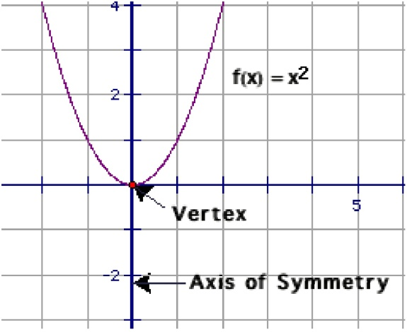
Additional (unnecessary because of graphing calc) Info
Standard Form: a function of the form
fx=ax2+bx+c where a≠0
Parabola: the “U shaped” graph that is formed by a quadratic function
Vertex Form: another way of writing a quadratic equation,
fx=a(x-h)2+k where a≠0
Note: it is called vertex form because are able to easily identify the vertex
Vertex: the highest (maximum) or lowest (minimum) point of a parabola where the axis of symmetry intersects our parabola (h, k)
Axis of Symmetry: The vertical line that divides are parabola into two mirror images of each other by passing through the vertex.
Parent Graph fx=x2

Slide 20
Steps to Graphing Quadratic Equation in Standard Form (WITHOUT a calculator – won’t ever have to do this, but just in case:
Identify a, b and c.
1) Find and Plot Vertex Substitute in x and solve for y
2) Draw Axis of Symmetry
Vertical line at (in other words, through the vertex)
3) Find and Plot two points on one side of axis of symmetry
Choose x values and solve for y values
4) Use symmetry to plot symmetric points on opposite side of axis of symmetry
5) Draw a parabola through the plotted points

